Slide 1
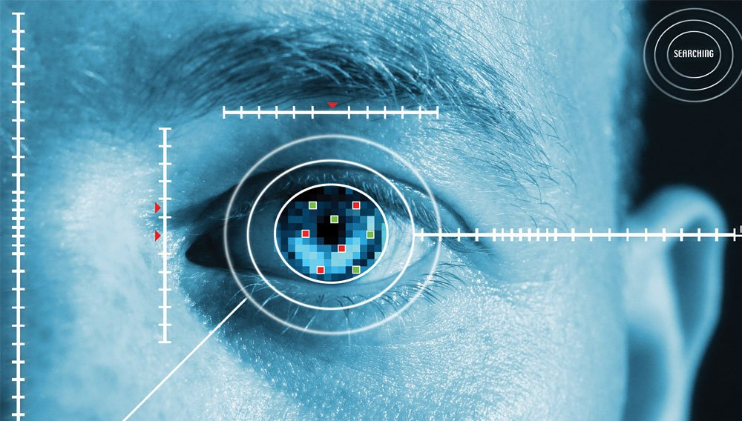
APTOS Blindness Detection
Deepti Kulkarni

Slide 2
Agenda
Project overview
Preprocessing
Baseline
Basic CNN
Variations in CNN- “Attempt”
Depth separable CNN
Transfer learning- ResNet, DenseNet
Model comparison
Predictions

Slide 3
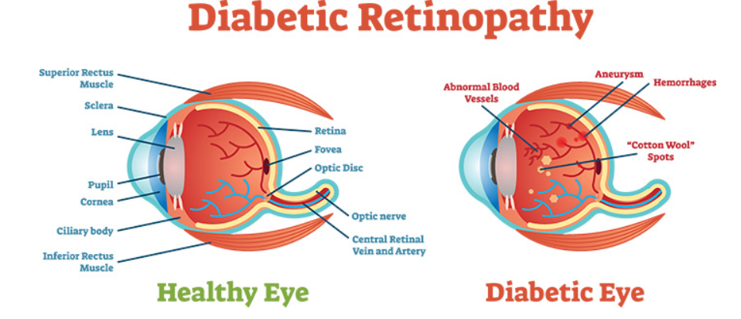
Project description

Slide 4
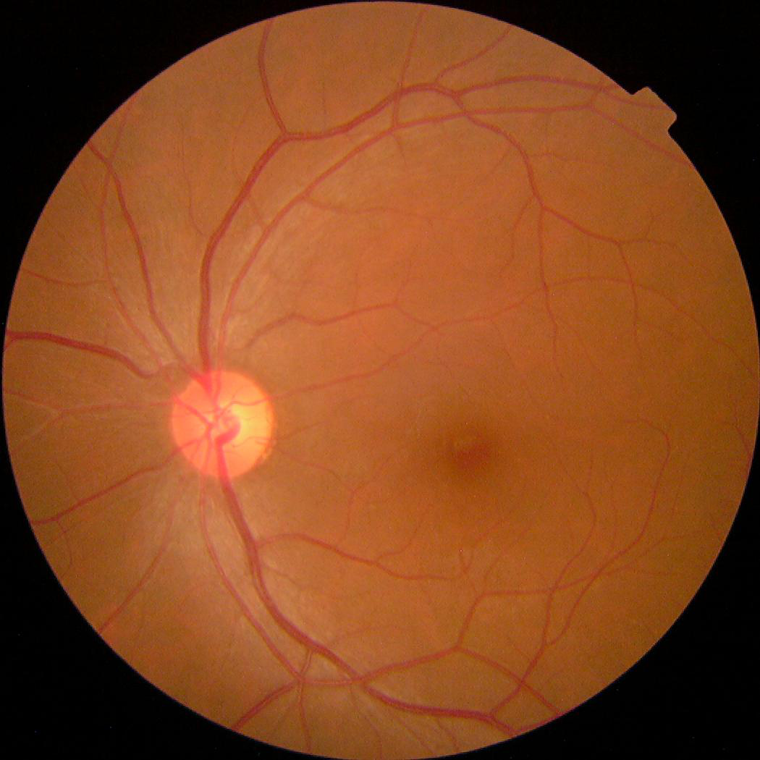
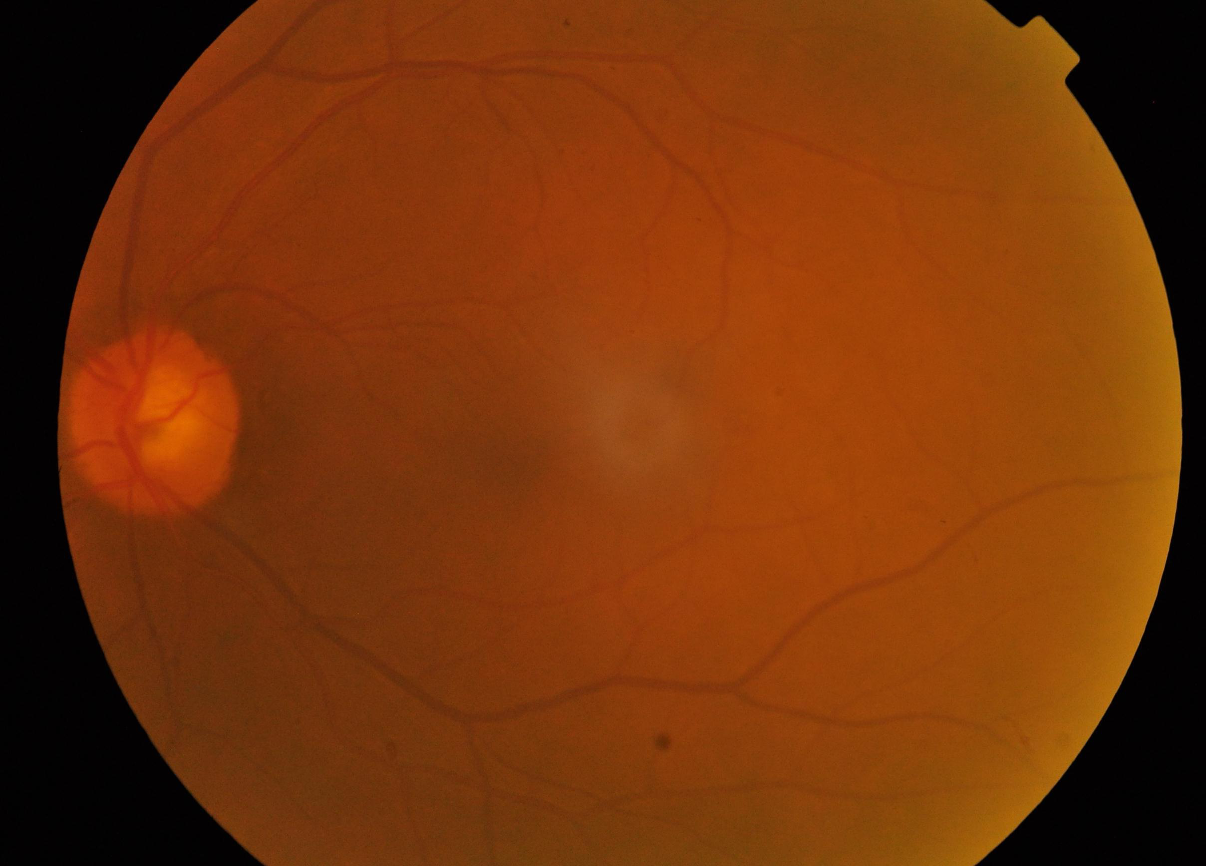
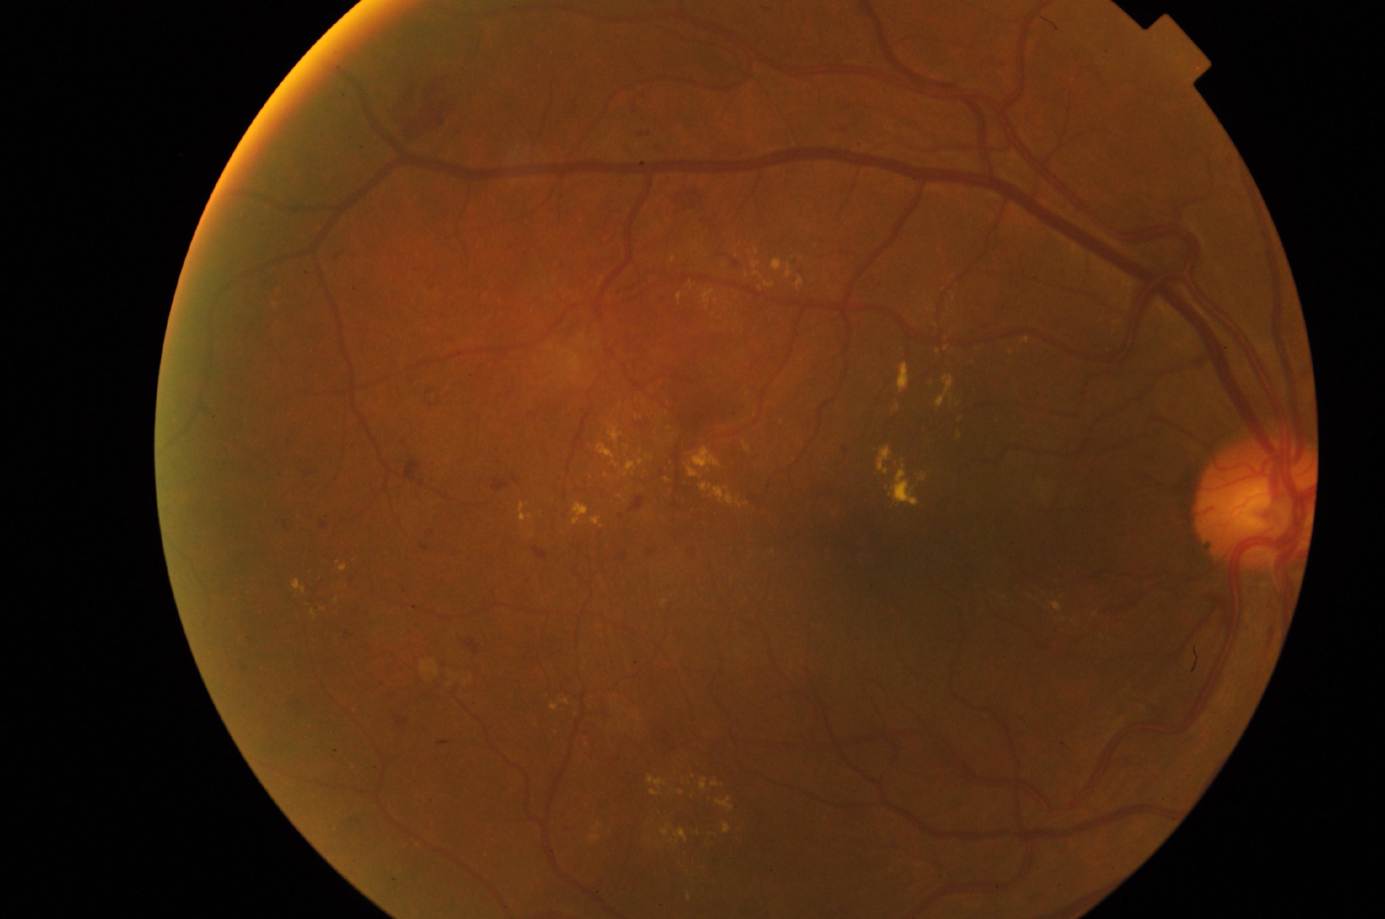
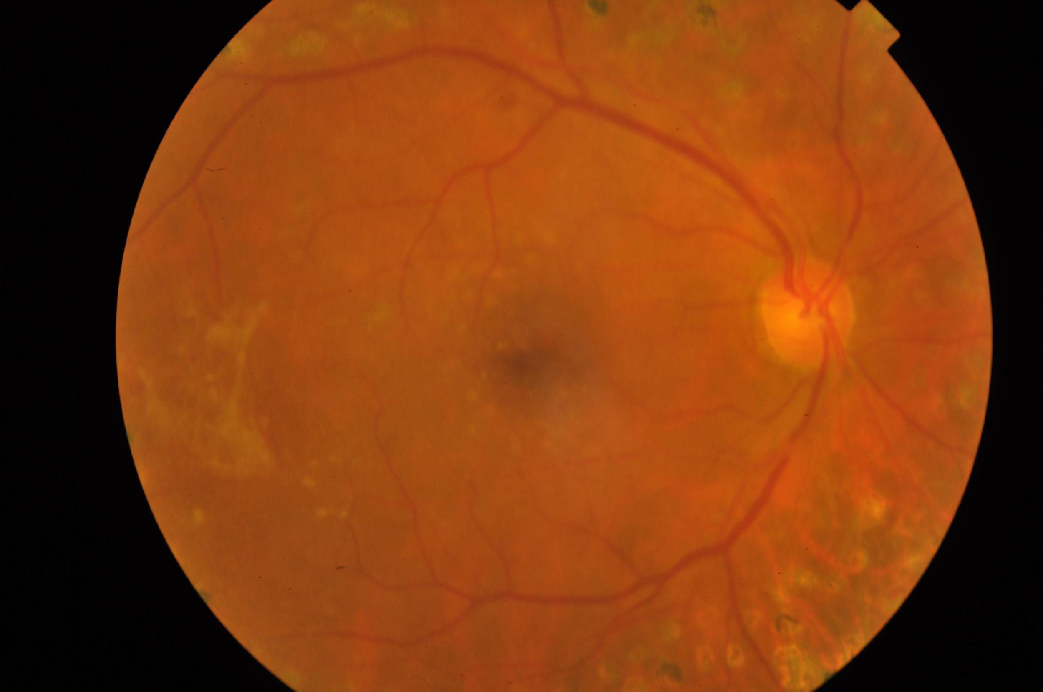
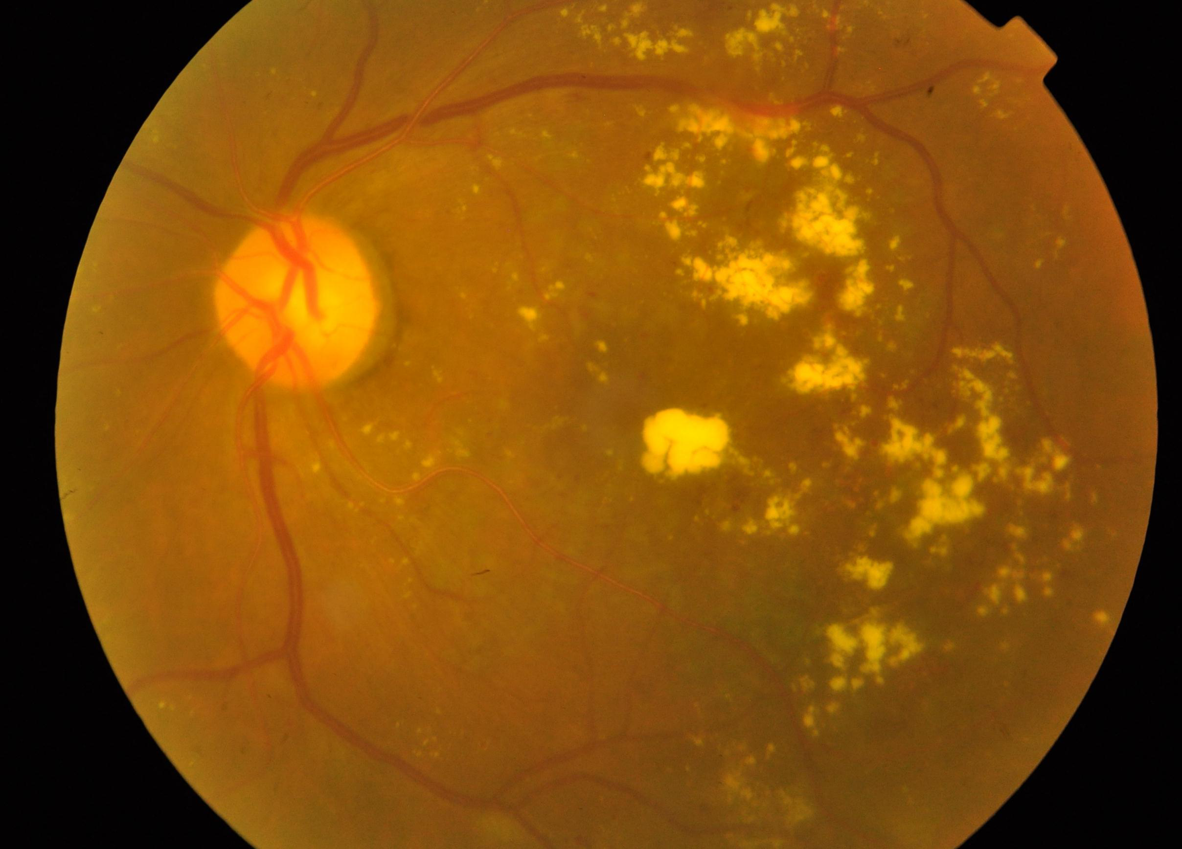
Data description-Classes
0 - No DR
1 - Mild
2 - Moderate
3 - Severe
4 - Proliferative DR

Slide 5
Preprocessing
Used Image data generator- flow_from_dataframe.
Reshaped all the images to (32,32)
Data Split: Training 75%, Validation 25%.
Data Augmentation(rotation, flipping, width shifting)

Slide 6
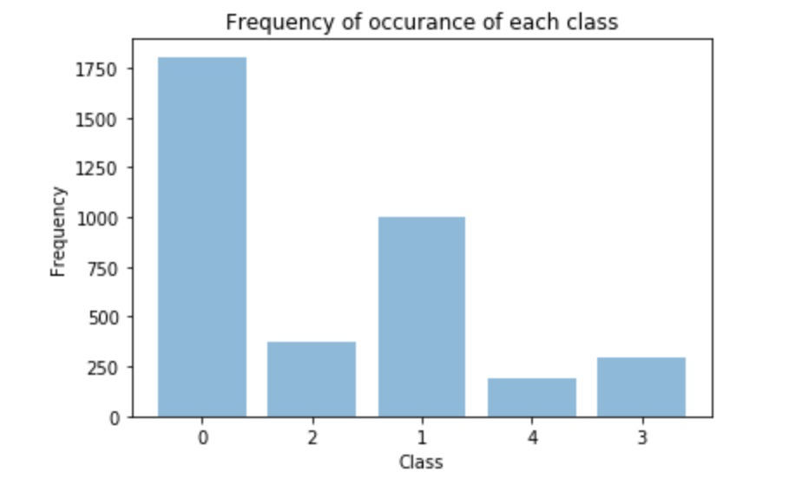
Baseline
The baseline accuracy: 32.28%

Slide 7
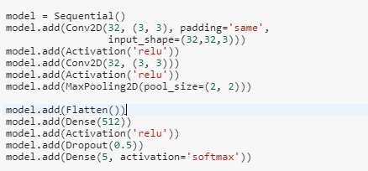
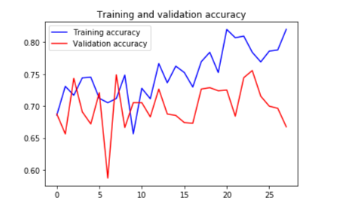
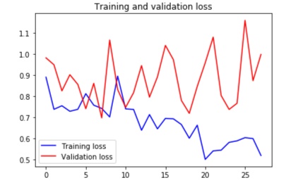
Basic CNN
The maximum validation accuracy: 80.44%
The optimizer used: RMSProp

Slide 8
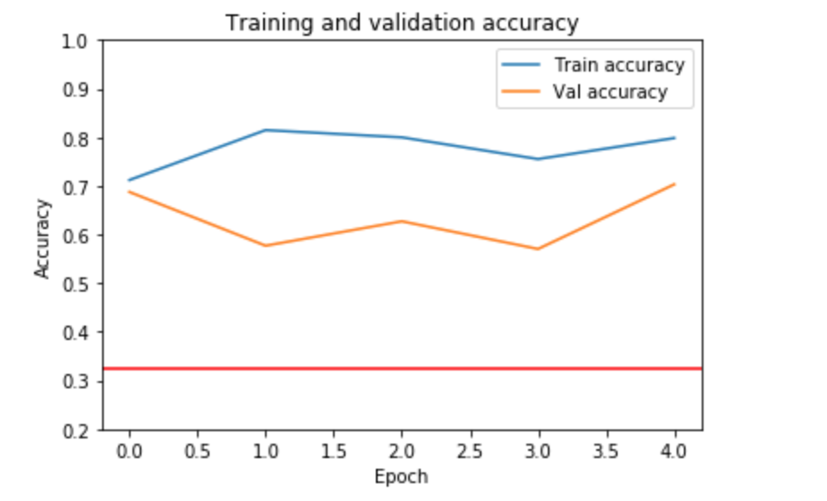
CNN with variations
From Basic CNN changing batch size to 64
For 5 epochs:
Validation accuracy : 70.31%
Training accuracy: 81.47%

Slide 9
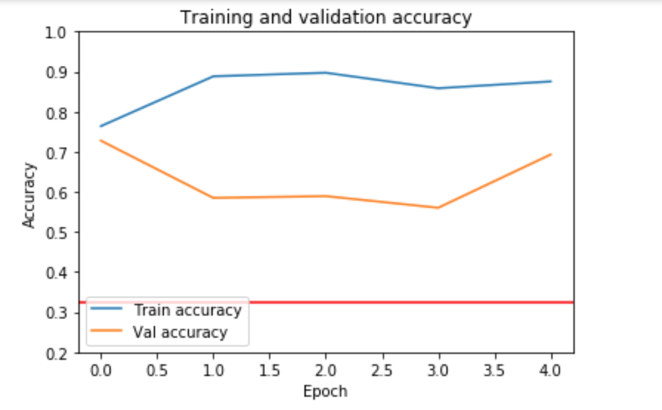
Variations with Hyperparameters
Reducing batch size to 32
Increasing no: of neurons + add another conv2d layer.
Validation accuracy: 72.76%
Training accuracy: 89.70%

Slide 10
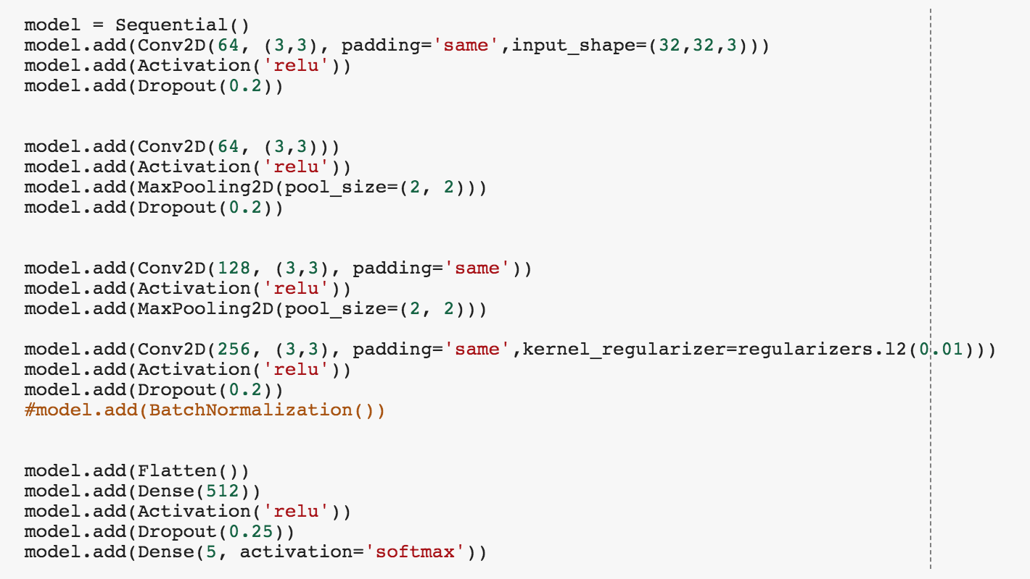
Variations with Hyperparameters
Epochs : 25
Model: 4 conv2D layers + 1 dense layers hidden
With l2 regularization to reduce generalization error
Epochs : 25
Optimizer : Rmsprop

Slide 11
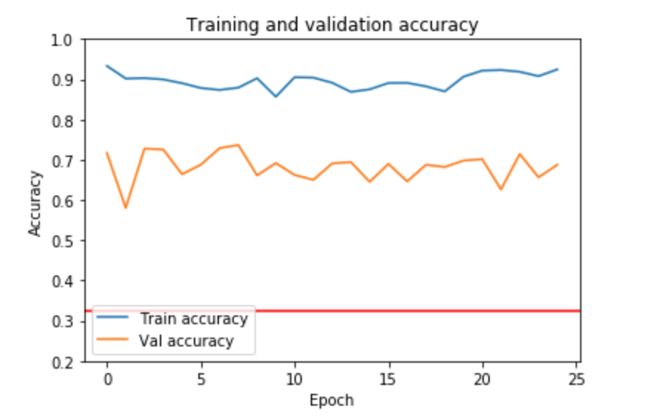
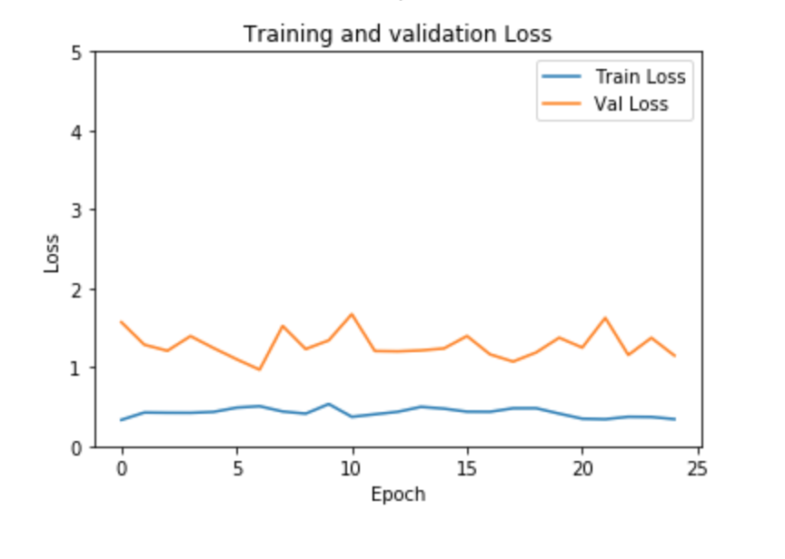
Performance
Maximum Validation Accuracy : 73.66%

Slide 12
Depth Separable convolution
Used to reduce the model size and complexity
Lesser model size
Lesser complexity
No of parameters in the CNN model : 3,699,621
No of parameters in the separable convolution : 43,461
Transforms the image only once in the depth wise convolution.
The transformed image is elongated to the number of output channels of the kernel.

Slide 13
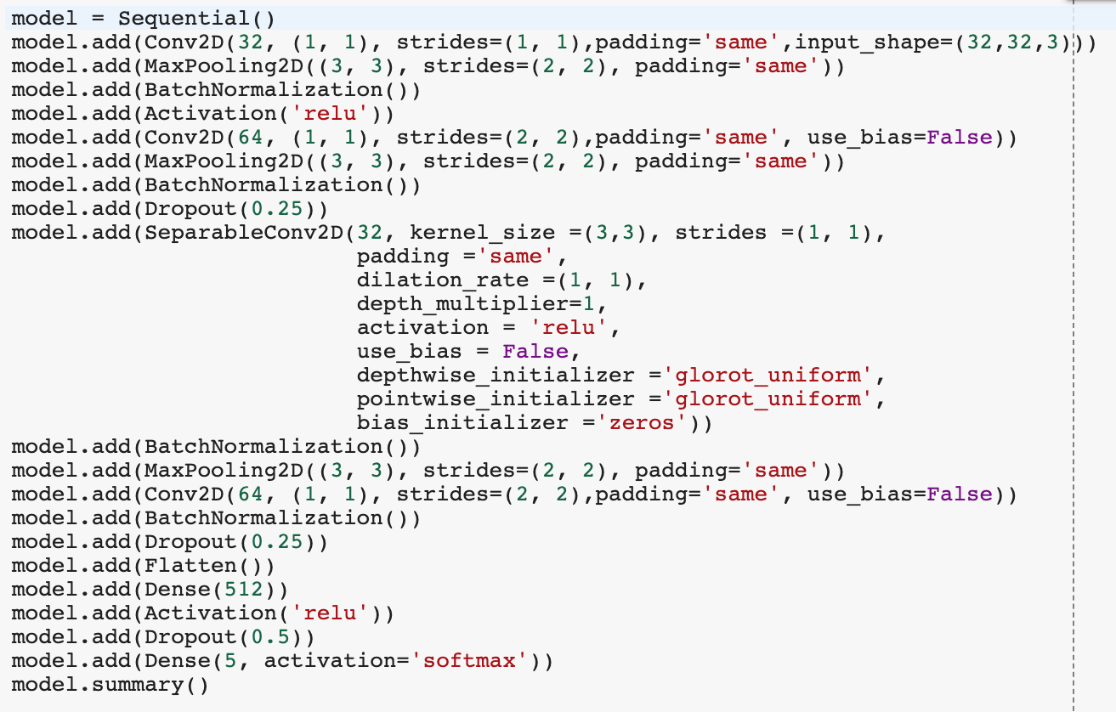
Model
Notes:
The separable layer is not added AT THE beginning because there are not enough initial weights to train the model.

Slide 14
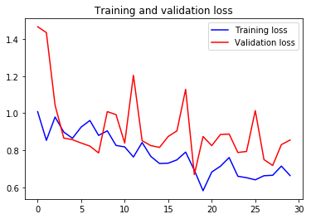
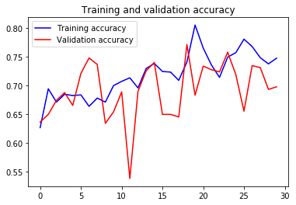
Model Performance
Maximum validation accuracy: 77.46%

Slide 15
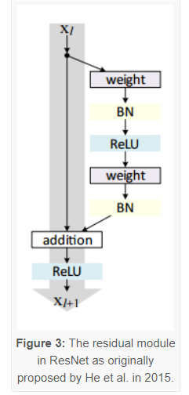
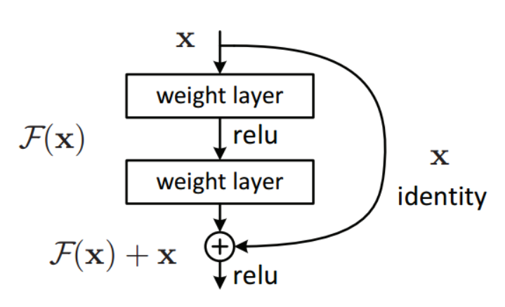
Transfer Learning- Residual Networks
Residual block gets added
Skip the training of one or more layers
Layers can be dropped depending on contribution
ResNet-50
Top-1 Accuracy – 74.9%
A single residual block
Transfer Learning model

Slide 16
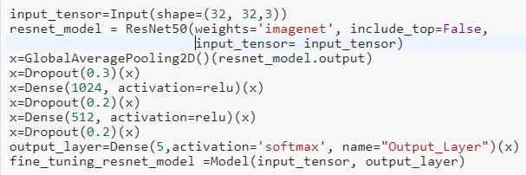
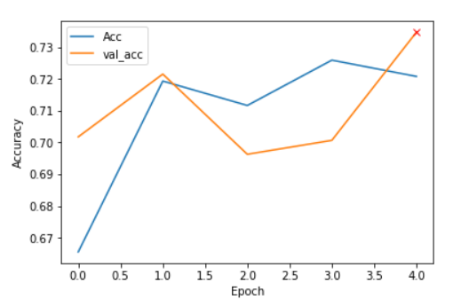
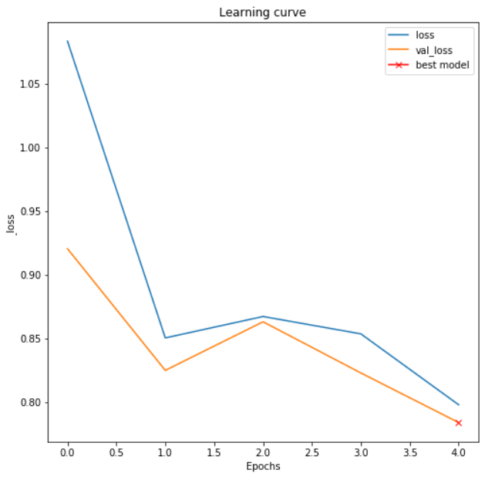
Basic ResNet50
Maximum Validation Accuracy: 73.46 %
Optimizer: RMSprop

Slide 17
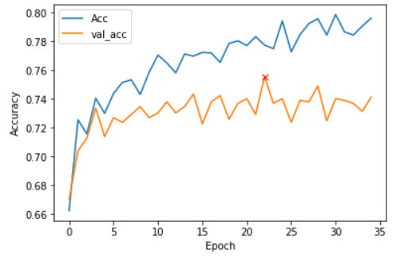
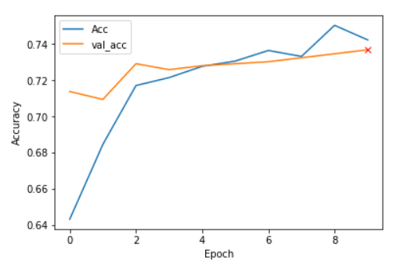
ResNet50 - Variation 1
Early stopping and more epochs
Accuracy - 75.55 %
ResNet50 – Variation 2
Batch Normalization
Accuracy: 73.68%

Slide 18
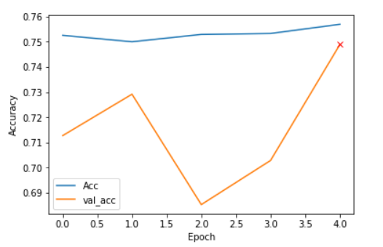
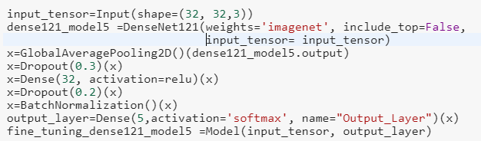
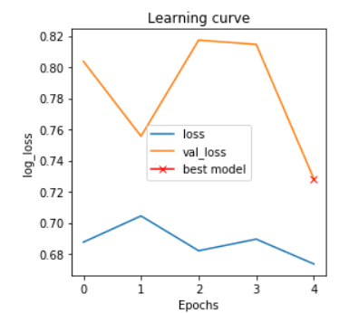
Transfer Learning - DenseNet121
Data Augmentation
Maximum Accuracy: 74.89%
DenseNet121: Requires fewer parameter

Slide 19
Model Comparison
Model | Validation Accuracy | Training Accuracy
CNN | 80.44% | 96.80%
CNN with Variations | 73.66% | 92.34%
Depth Separable CNN | 77.46% | 79.63%
Transfer Learning – ResNet50 | 75.55% | 77.73%
Transfer Learning – DenseNet121 | 74.89% | 75.65%

Slide 20
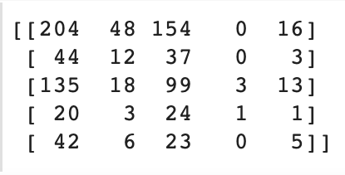
Confusion matrix for the best model
The diagonal elements represent the number of points for which the predicted label is equal to the true label
Off-diagonal elements are those that are mislabeled by the classifier.
The higher the diagonal values of the confusion matrix the better.

Slide 21
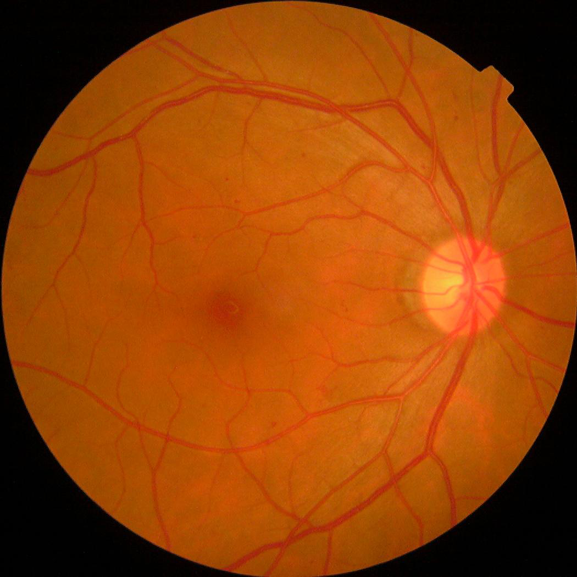
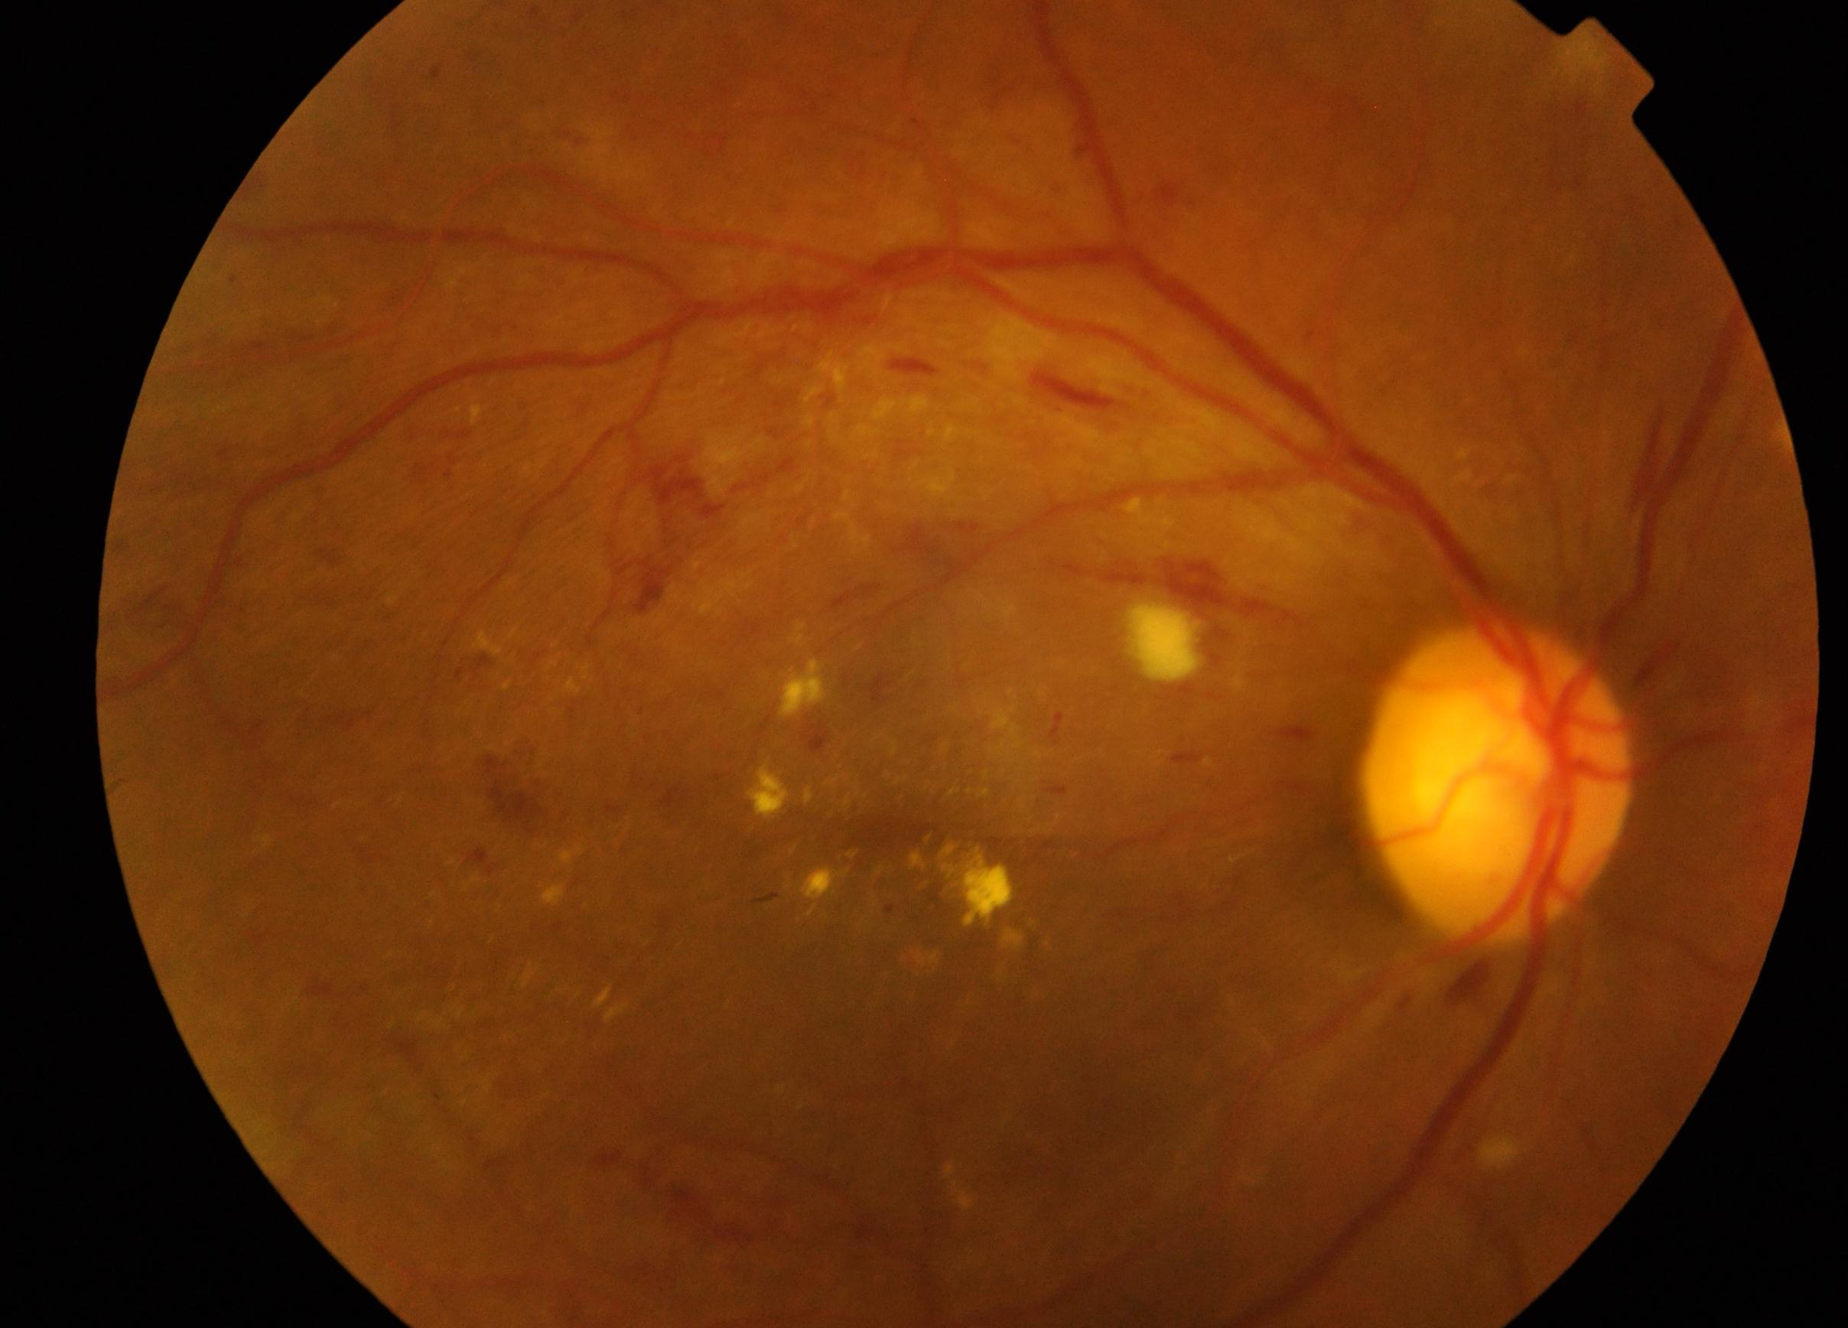
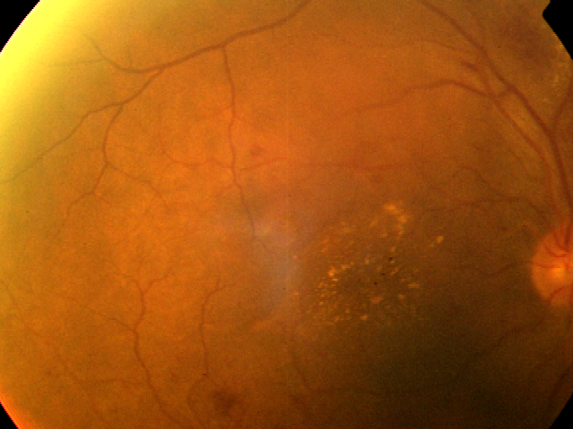
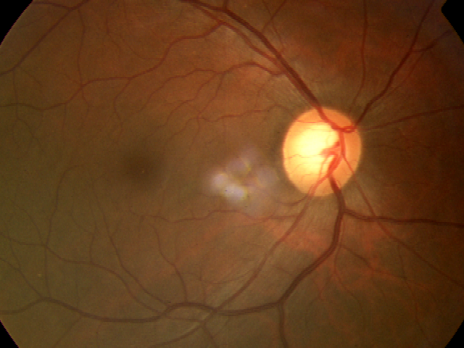
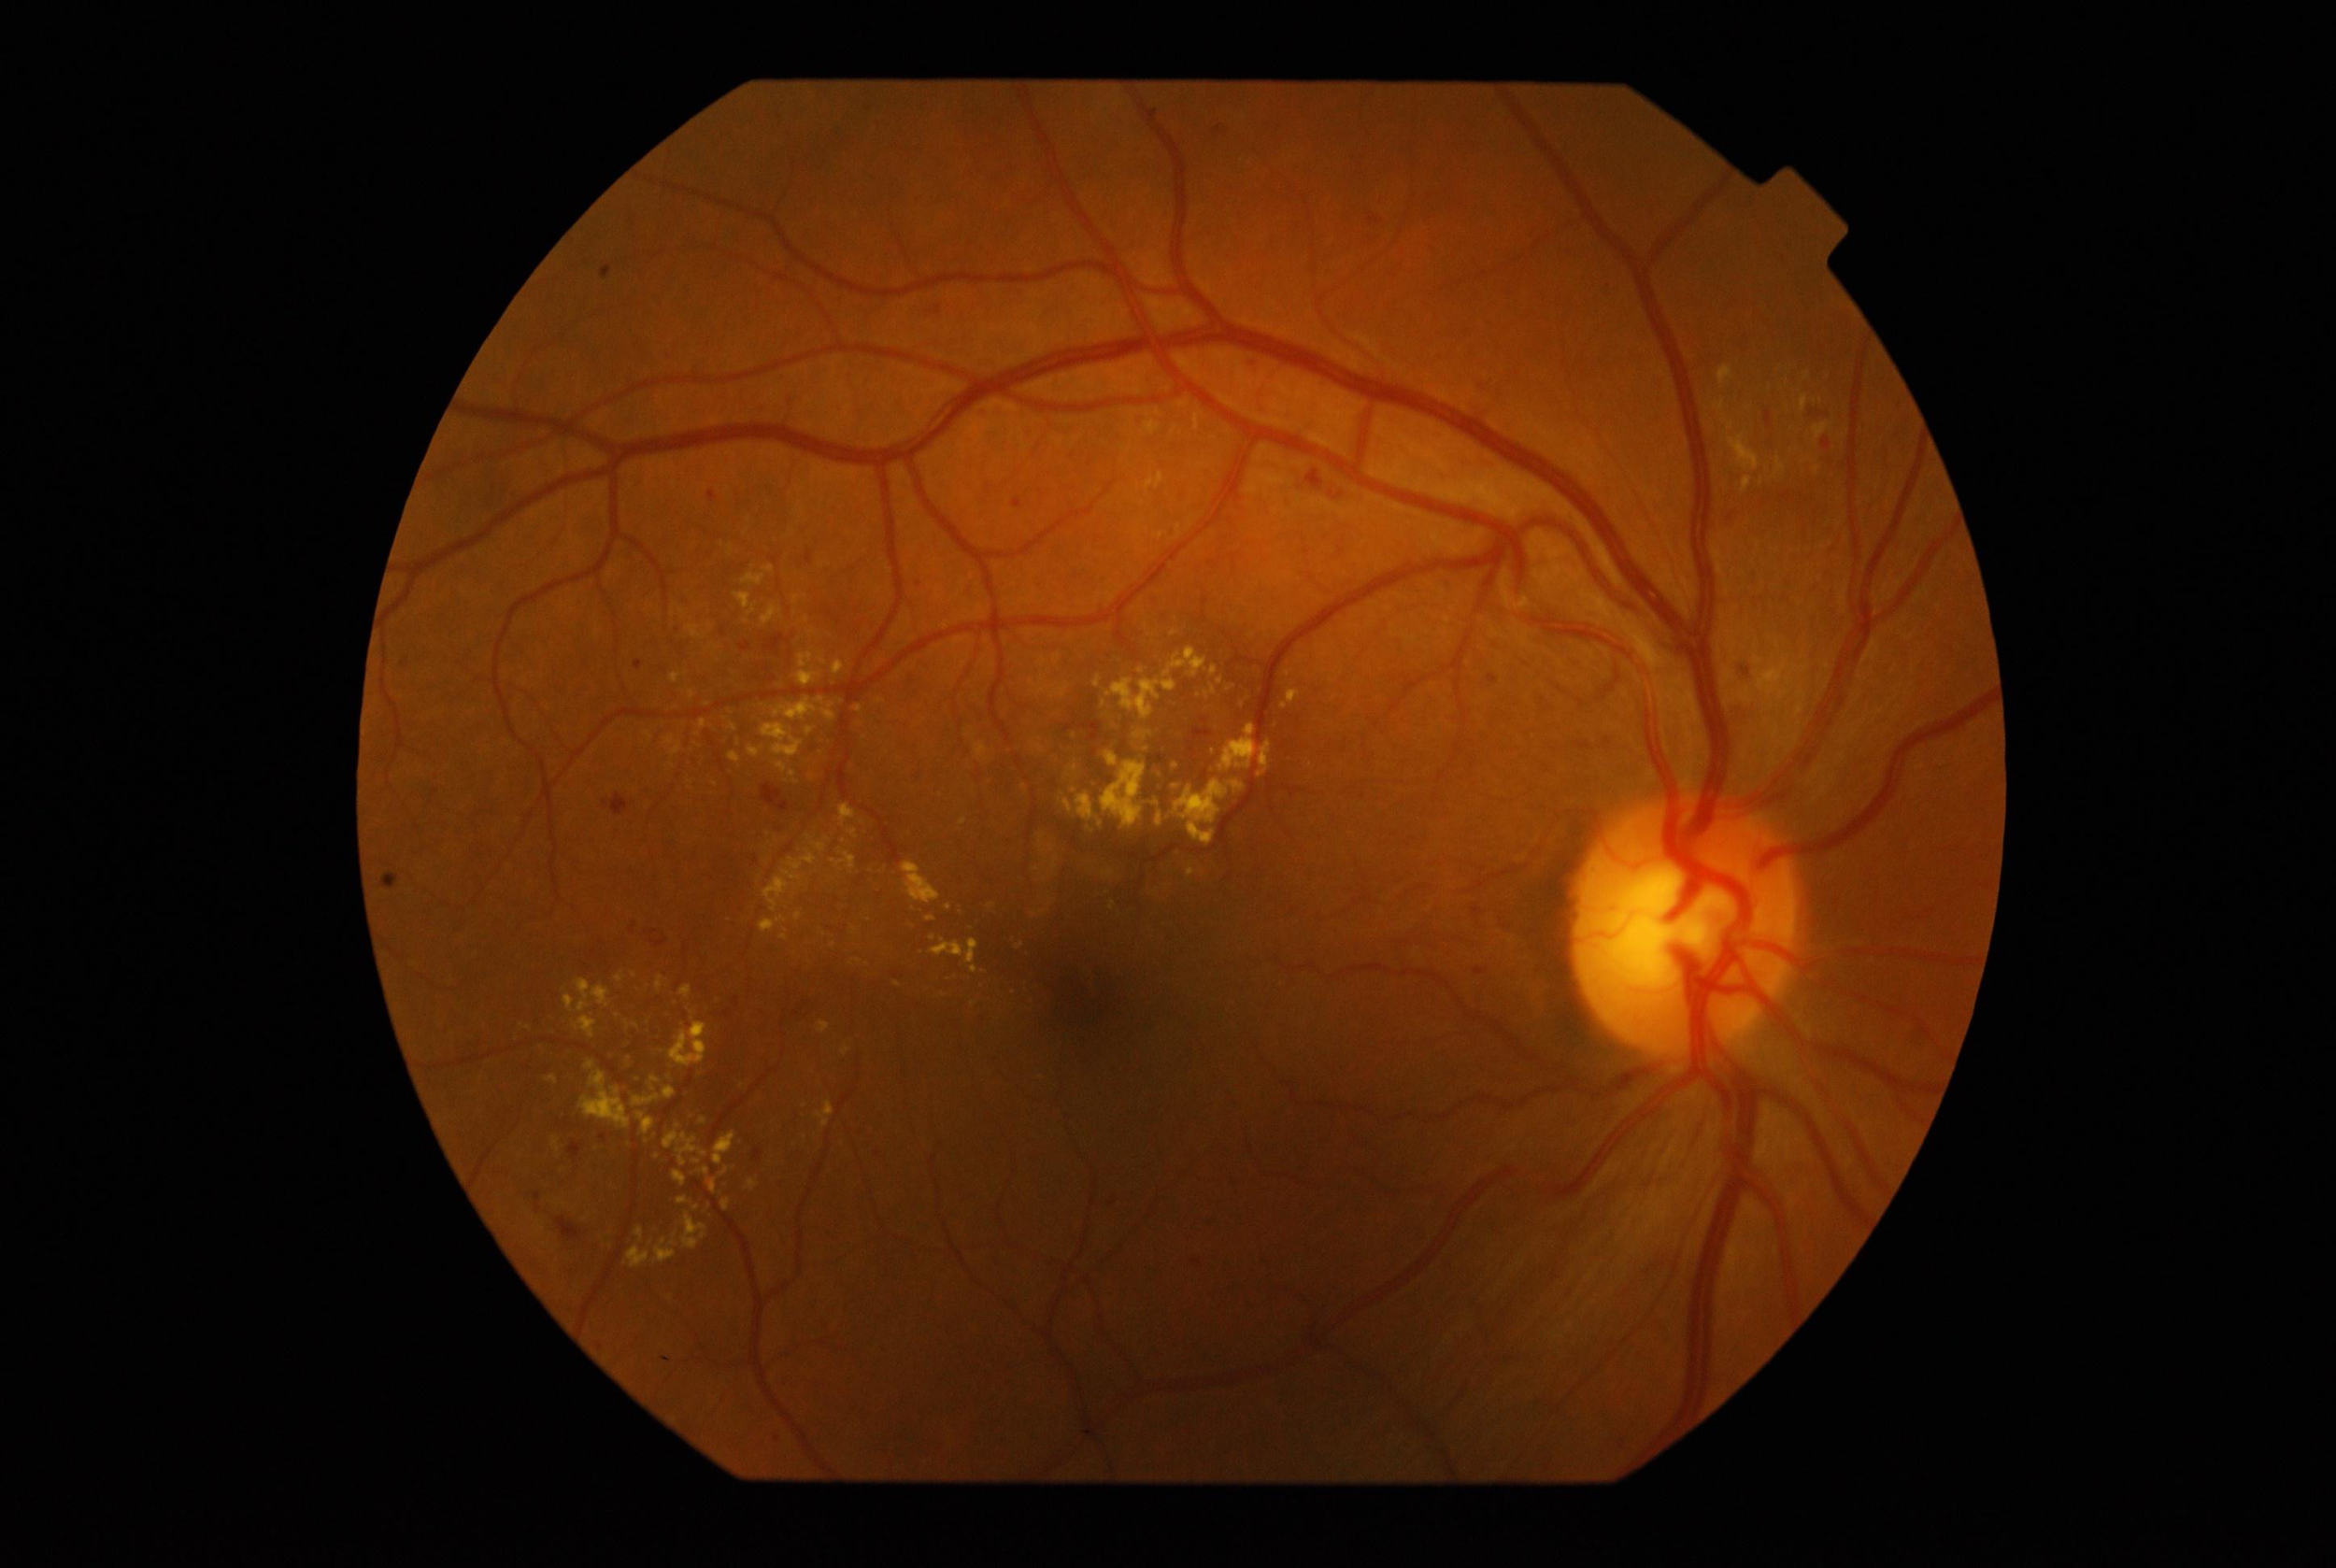
Predictions on Test data
0 – No DR
1 - Mild
2 - Moderate
3 – Severe
4- Proliferative DR

Slide 22
Any Questions?

